Slide 1
Prediction of Remaining Useful Life for AeroEngines

Slide 2
Contents of the presentation
Project Description
Problem Statement
Objective
Scope
Literature Survey
Significant
Proposed System
Project flow
Resource Requirements
Architecture
UMLS
Research Gap analysis
Implementation
  1. Data Description
  2. EDA Explanation
  3. Preprocessing steps
  Model Implementation
1. Algorithm Definition
2. working Process
3. Results from Algorithm
  Performance comparison
  Output Screen
  Future Scope
  Conclusion

Slide 3
Project Description
The prediction of Remaining Useful Life (RUL) in aeroengines plays a crucial role in modern predictive maintenance strategies within the aviation industry. Accurate estimation of RUL not only reduces operational costs but also enhances safety, efficiency, and reliability by preventing unexpected engine failures. This project, titled “Prediction of Remaining Useful Life for AeroEngines”, explores the application of advanced machine learning algorithms to analyze sensor and operational data for forecasting engine degradation patterns. Several models, including Random Forest, Extra Trees Regressor, Gradient Boosting, XGBoost, K-Nearest Neighbors (KNN), Feedforward Neural Networks (FNN), and Multi-Layer Perceptrons (MLP), are developed and rigorously evaluated. Performance is measured using Mean Squared Error (MSE) and R² Score, with the Extra Trees Regressor and MLP models emerging as the most effective in delivering reliable and accurate predictions of aeroengine RUL.

Slide 4
Project Description
To ensure transparency in decision-making, Explainable AI (XAI) techniques such as SHAP are employed, offering insights into feature importance and model interpretability. The proposed solution is implemented as a Flask-based web application that enables users to upload datasets, compare model performances, and obtain real-time RUL predictions. Furthermore, the system incorporates health state categorization—NORMAL, WARNING, and CRITICAL—and provides actionable maintenance recommendations. This research contributes to proactive aviation maintenance scheduling and minimizes risks associated with unforeseen engine breakdowns.
Keywords: Remaining Useful Life, Aeroengines, Machine Learning, Extra Trees, Multi-Layer Perceptron, Predictive Maintenance, Explainable AI, SHAP, Flask Application, Aviation Reliability

Slide 5
Problem Statement
Aeroengines are among the most critical components in aviation, where even minor failures can lead to severe consequences, including safety risks, operational disruptions, and high maintenance costs. Traditional maintenance practices, such as scheduled inspections or corrective maintenance, often result in either premature servicing or unexpected breakdowns. These approaches lack efficiency and fail to leverage the vast amount of sensor and operational data collected from modern engines. The challenge lies in accurately predicting the Remaining Useful Life (RUL) of aeroengines to enable timely and proactive maintenance actions. Developing robust, interpretable, and deployable machine learning models for RUL prediction is therefore essential to enhance safety, reduce downtime, and optimize the overall reliability of aviation operations.

Slide 6
Objective of the Project
The objective of this project is to develop an intelligent, AI-driven framework for predicting the life expectancy and Remaining Useful Life (RUL) of implantable medical devices such as pacemakers and defibrillators. These devices are vital for sustaining patient health and safety, and their timely maintenance or replacement is crucial in avoiding critical failures. The proposed system employs a data-centric approach using regression-based machine learning and deep learning models to forecast device deterioration based on historical and real-time operational parameters. Unlike conventional threshold-based monitoring systems that only trigger alerts after issues arise, this predictive system proactively analyzes patterns and trends in device behavior to provide early warnings. The core goal is to integrate a robust predictive layer into healthcare infrastructure that enables preventive action and improves patient outcomes.

Slide 7
Scope
This project covers the end-to-end development of a predictive maintenance solution tailored for aeroengines. The scope includes data preprocessing, feature engineering, training of machine learning models, and comparative evaluation of algorithms. Advanced models like Extra Trees Regressor and MLP are emphasized for their predictive accuracy, while SHAP-based interpretability enhances transparency in decision-making. The project further extends to deploying the solution as a user-friendly Flask web application, enabling dataset uploads, model comparison, and real-time RUL prediction. Additionally, the system categorizes engine health states (NORMAL, WARNING, CRITICAL) and suggests maintenance strategies accordingly. However, the project is limited to the datasets used for model training and does not include integration with live aircraft systems or real-time sensor streaming.

Slide 8
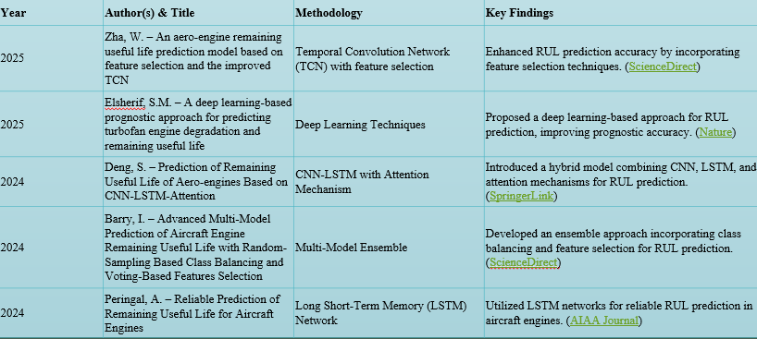
Literature Survey

Slide 9
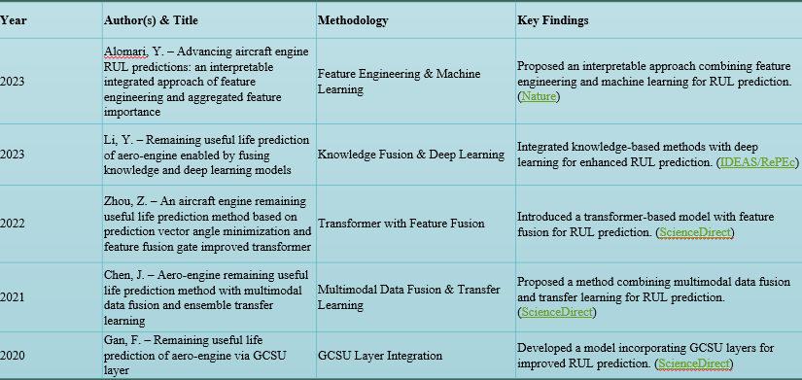
Literature Survey

Slide 10
Significant
The accurate prediction of Remaining Useful Life (RUL) in aeroengines is of paramount importance in modern aviation, where safety, reliability, and operational efficiency are critical. Unanticipated engine failures can result in severe safety hazards, unscheduled maintenance, and significant financial losses for airlines. Traditional maintenance strategies, such as scheduled or reactive maintenance, often fail to optimize the use of engine components, either causing premature replacements or overlooking impending failures. Predictive maintenance, enabled through advanced data-driven approaches, addresses these limitations by leveraging real-time and historical sensor data to forecast engine health accurately. This project demonstrates the application of advanced machine learning techniques to predict aeroengine RUL. By integrating models such as Random Forest, Extra Trees Regressor, Gradient Boosting, XGBoost, K-Nearest Neighbors (KNN), Feedforward Neural Networks (FNN), and Multi-Layer Perceptrons (MLP), the study identifies the Extra Trees Regressor and MLP as the most effective in producing reliable predictions.

Slide 11
Significant
The use of Explainable AI (XAI) techniques like SHAP adds a layer of transparency, allowing maintenance engineers and decision-makers to understand the contribution of each sensor and operational feature to the model’s predictions.
The implementation as a Flask-based web application provides a user-friendly platform for real-time prediction, comparison of model performance, and actionable maintenance guidance. Furthermore, the system categorizes engine health into NORMAL, WARNING, and CRITICAL states, enabling proactive intervention and reducing operational risks. Overall, this work significantly contributes to the aviation industry by enhancing predictive maintenance capabilities, improving aircraft availability, reducing costs, and safeguarding passengers and crew through data-driven insights into engine performance.

Slide 12
Proposed System
The proposed system is a data-driven, machine learning-based platform for predicting the Remaining Useful Life (RUL) of aeroengines. It collects sensor and operational data from engines and applies preprocessing and feature extraction techniques to prepare the data for modeling. Multiple machine learning models—including Random Forest, Extra Trees Regressor, Gradient Boosting, XGBoost, KNN, FNN, and MLP—are developed and evaluated for performance, with Extra Trees and MLP identified as the most reliable predictors. Explainable AI (XAI) using SHAP provides transparency, highlighting the influence of each feature on the RUL predictions. The system is deployed as a Flask web application, enabling users to upload datasets, generate real-time predictions, compare models, and categorize engine health into NORMAL, WARNING, or CRITICAL, along with actionable maintenance recommendations.

Slide 13
ADVANTAGES
Proactive Maintenance – Enables timely maintenance interventions, reducing the likelihood of unexpected engine failures.
Cost Efficiency – Minimizes unnecessary part replacements and operational downtime, lowering overall maintenance costs.
Improved Safety and Reliability – Enhances aircraft operational safety by accurately predicting engine degradation trends.
Interpretability – SHAP-based Explainable AI provides transparency in model predictions, allowing engineers to understand feature contributions.
Real-Time Decision Support – Flask-based web application facilitates real-time RUL predictions, model comparisons, and actionable maintenance recommendations.

Slide 14
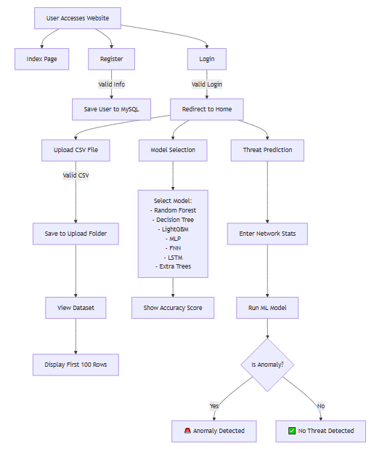
PROJECT FLOW

Slide 15
Resource Requirements
01
Hardware
(Processor: I5/Intel Processor, RAM: 8GB (min), Hard Disk: 128 GB, Key Board: Standard Windows Keyboard, Mouse: Two or Three Button Mouse)
Resources
02
Software
(Operating System: Windows 10, Programming Language: Python 3.10.8, IDE: VS Code)
Packages/Libraries
03
(Django, Scikit-learn, Pandas, Numpy, Imblearn and Matplotlib.

Slide 16
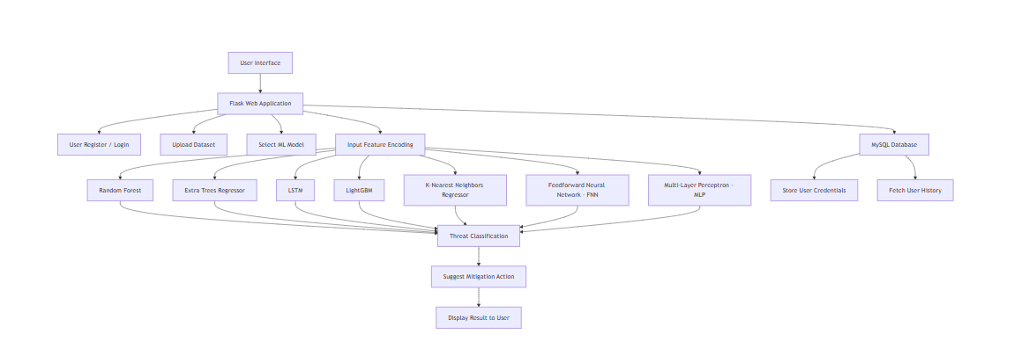
Architecture

Slide 17
    UML DIAGRAMS
Use Case Diagram:
  1) A use case diagram in the Unified Modeling Language (UML) is a type of behavioral diagram defined by and created from a Use-case analysis.
  2) Its purpose is to present a graphical overview of the functionality provided by a system in terms of actors, their goals (represented as use cases), and any dependencies between those use cases.
  3) The main purpose of a use case diagram is to show what system functions are performed for which actor. Roles of the actors in the system can be depicted.

Slide 18
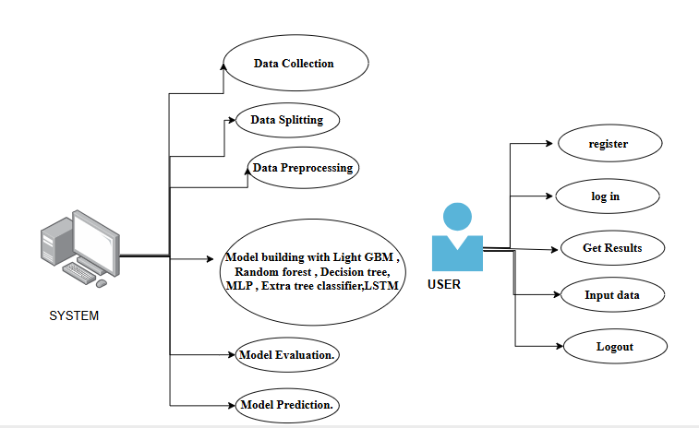
Figure: Use Case Diagram

Slide 19
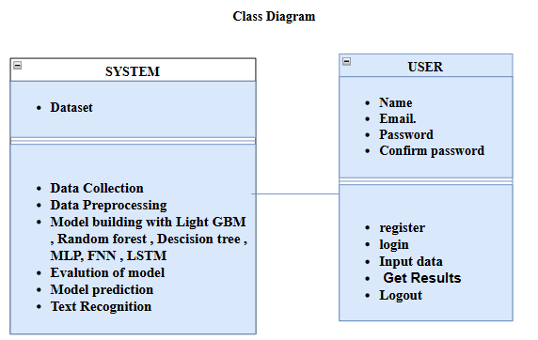
Class Diagram:
In software engineering, a class diagram in the Unified Modeling Language (UML) is a type of static structure diagram that describes the structure of a system by showing the system's classes, their attributes, operations (or methods), and the relationships among the classes. It explains which class contains information

Slide 20
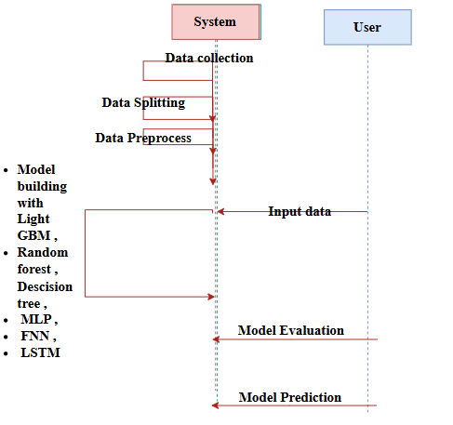
Sequence Diagram:
A sequence diagram in Unified Modeling Language (UML) is a kind of interaction diagram that shows how processes operate with one another and in what order.
It is a construct of a Message Sequence Chart. Sequence diagrams are sometimes called event diagrams, event scenarios, and timing diagrams
Figure: Sequence diagram

Slide 21
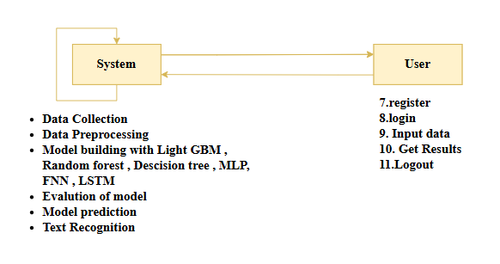
Collaboration Diagram:
In collaboration diagram the method call sequence is indicated by some numbering technique as shown below. The number indicates how the methods are called one after another. We have taken the same order management system to describe the collaboration diagram. The method calls are similar to that of a sequence diagram. But the difference is that the sequence diagram does not describe the object organization whereas the collaboration diagram shows the object organization.
Figure: Collaboration diagram

Slide 22

Deployment Diagram
Deployment diagram represents the deployment view of a system. It is related to the component diagram. Because the components are deployed using the deployment diagrams. A deployment diagram consists of nodes. Nodes are nothing but physical hardware’s used to deploy the application.
Figure: Deployment diagram

Slide 23
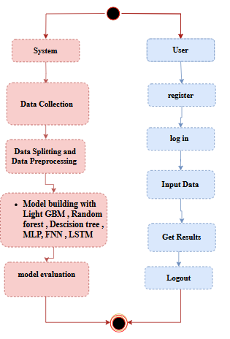
Activity Diagram:
Activity diagrams are graphical representations of workflows of stepwise activities and actions with support for choice, iteration and concurrency. In the Unified Modelling Language, activity diagrams can be used to describe the business and operational step-by-step workflows of components in a system. An activity diagram shows the overall flow of control.
Figure: Activity diagram

Slide 24
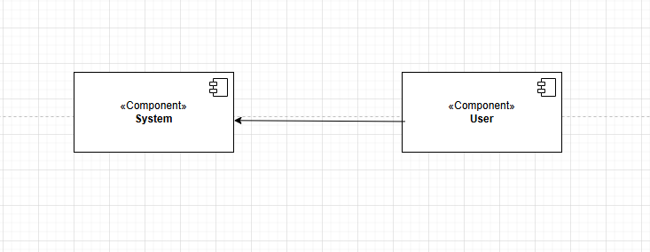
Component Diagram:
A component diagram, also known as a UML component diagram, describes the organization and wiring of the physical components in a system. Component diagrams are often drawn to help model implementation details and double-check that every aspect of the system's required function is covered by planned development.
Figure: Component diagram

Slide 25
ER Diagram:
An Entity–relationship model (ER model) describes the structure of a database with the help of a diagram, which is known as Entity Relationship Diagram (ER Diagram). An ER model is a design or blueprint of a database that can later be implemented as a database. The main components of E-R model are: entity set and relationship set.
An ER diagram shows the relationship among entity sets. An entity set is a group of similar entities and these entities can have attributes. In terms of DBMS, an entity is a table or attribute of a table in database, so by showing relationship among tables and their attributes, ER diagram shows the complete logical structure of a database. Let’s have a look at a simple ER diagram to understand this concept.

Slide 26
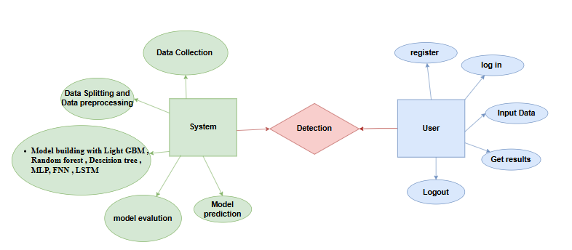
Figure: ER diagram

Slide 27
DFD Diagram:
A Data Flow Diagram (DFD) is a traditional way to visualize the information flows within a system. A neat and clear DFD can depict a good amount of the system requirements graphically. It can be manual, automated, or a combination of both. It shows how information enters and leaves the system, what changes the information and where information is stored. The purpose of a DFD is to show the scope and boundaries of a system as a whole. It may be used as a communications tool between a systems analyst and any person who plays a part in the system that acts as the starting point for redesigning a system.
Figure: Context Level diagram

Slide 28
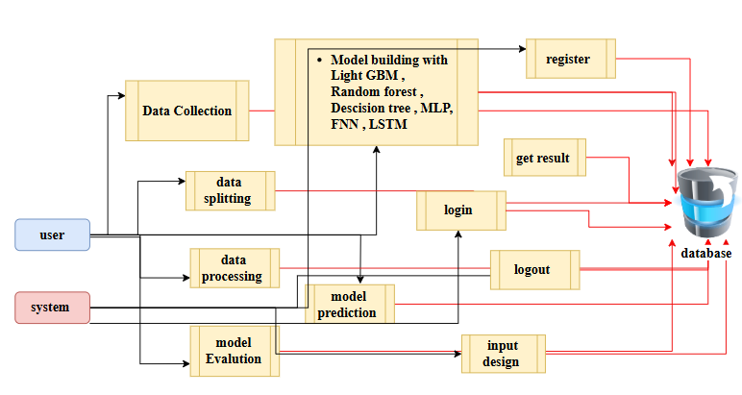
FigureLevel-1 diagram

Slide 29
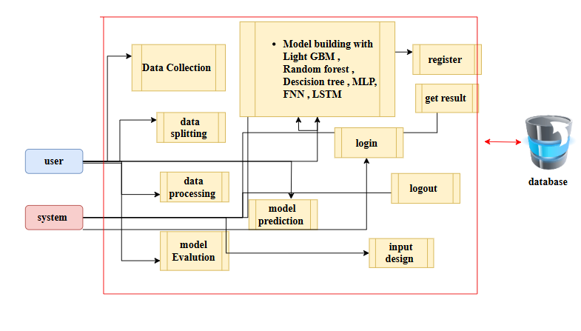
Figure:Level-2 diagram

Slide 30
Research Gap analysis
Despite extensive research in the prediction of Remaining Useful Life (RUL) for aeroengines, several gaps persist that limit the full potential of predictive maintenance in aviation. Traditional approaches often rely on statistical or physics-based models, which may not efficiently capture the complex nonlinear relationships present in high-dimensional sensor and operational datasets. While recent studies have employed machine learning and deep learning models such as Random Forest, Gradient Boosting, and LSTM networks, many of these approaches focus primarily on predictive accuracy without addressing model interpretability. This lack of transparency creates challenges for maintenance engineers who need to understand the factors driving predictions to make informed decisions.
Another significant gap is the integration of RUL prediction models into practical, user-friendly platforms for real-time deployment. Most studies remain at a theoretical or experimental stage, with limited focus on web-based or application-level solutions that allow operators to upload datasets, generate predictions, and compare multiple models simultaneously.

Slide 31
Research Gap analysis
Additionally, health state categorization—translating continuous RUL predictions into actionable maintenance states such as NORMAL, WARNING, or CRITICAL—is often not systematically implemented, reducing the operational usability of these models.
Furthermore, while various machine learning models have been explored, few studies conduct a comparative analysis emphasizing the performance of ensemble tree-based models like Extra Trees Regressor and neural architectures like Multi-Layer Perceptrons (MLP) in combination with explainable AI techniques. The integration of SHAP-based interpretability with high-performing models is still limited in the literature, leaving a gap in understanding feature contributions for critical maintenance decisions.
This project addresses these gaps by combining high-accuracy predictive models (Extra Trees and MLP) with SHAP explainability, deploying the solution as a Flask-based application for real-time usability, and incorporating health state categorization. Thus, it contributes both technically and operationally to aviation predictive maintenance, bridging the gap between advanced RUL prediction and practical implementation.

Slide 32
System Modules
Implementation
1.1 Data Upload and Acquisition Module
This module is accessible via the /upload route and supports CSV-based dataset uploads for clinical telemetry related to battery-powered medical devices. Key features include cycle index, discharge time, voltage thresholds, and charging durations. Pandas is used to parse the uploaded data, and the first 500 rows are displayed in a structured preview. This allows clinicians or researchers to verify the input format before proceeding with model evaluation or prediction. The same form can also be bypassed for real-time manual data entry through the /prediction route.
1.2 Data Validation and Preprocessing Module
All user inputs (manual or from datasets) are checked for validity to ensure type correctness (e.g., float), non-null values, and safe ranges (e.g., voltage and time durations). This step is critical to preventing inference errors and maintaining prediction accuracy. Backend logic ensures robust parsing, and meaningful feedback is provided in case of user error via flash() messages.

Slide 33
Implementation
System:
1.3 Model Selection and Evaluation Module
At the /model route, users can choose from multiple machine learning models: Random Forest, Gradient Boosting, Decision Tree, KNN, MLP, LSTM, and SVR. Each model is pre-evaluated and associated with MSE and R² metrics that are dynamically displayed. This interface helps users select the most suitable model for medical device RUL prediction, enhancing transparency in performance comparison and fostering user trust.
1.4 Prediction and Inference Module
This module is the heart of the application, built into the /prediction route. After capturing eight telemetry parameters, the input is passed into a serialized Decision Tree model loaded using Joblib. The model returns a numerical prediction representing the device’s RUL. The prediction is processed and presented along with health classification (e.g., Healthy, Observation, Critical) on value_predict.html.

Slide 34
Implementation
System:
1.5 Rule-Based Classification and Health Status Mapping
To enhance usability and aid in diagnosis, the RUL prediction is mapped into actionable categories:
🟢 Healthy: RUL > 1000
🟠 Observation Needed: 500 < RUL ≤ 1000
🔴 Critical: RUL ≤ 500
This logic allows doctors or technicians to interpret raw prediction data in an intuitive, patient-focused manner.
1.6 Security and Session Management
The application supports secure login and registration through /login and /register routes. Key security features include:
CSRF protection via Flask-WTF
Session handling for all sensitive routes
Flash-based feedback for events like invalid login or duplicate email
Currently, passwords are stored in plaintext but future enhancements include password hashing with bcrypt and token-based email verification.

Slide 35
2. User:
2.1 Registration
The /register module checks for existing emails (case-insensitive) and validates password match before creating a new user entry in the MySQL user3 table.
2.2 Login and Session Handling
Users authenticate via the /login route. Sessions restrict access to private pages like /upload, /prediction, and /model, ensuring that only logged-in users can interact with the system securely.
2.3 Dataset Upload and Manual Input
Users can upload .csv files through the /upload interface or manually input data through /prediction for real-time predictions.

Slide 36
2. User:
2.4 Model Evaluation Interface
The /model route displays a dropdown of available models. When selected, the MSE and R² scores are displayed, helping the user choose the most accurate model.
2.5 Prediction Output Visualization
Upon submitting telemetry inputs, the predicted RUL is displayed along with its classification and interpretation in value_predict.html. This presentation style ensures clarity and supports real-time medical decision-making.
2.6 Logout and Session Termination
Secure logout ensures that session data is cleared, maintaining user privacy and access control.

Slide 37
Implementation
Data Analysis
Model Implementation
01
Data Description
04
Algorithm Definition
02
EDA Explanation
05
Working Process
03
Preprocessing steps
06
Results from Algorithm

Slide 38
1.Data set Description:
The dataset used in this project captures sensor and operational telemetry data from multiple aeroengines and serves as the foundation for predicting the Remaining Useful Life (RUL
Columns and Features
cycle – This column represents the operating cycle number and acts as a temporal index, enabling the models to track the progression of engine wear and degradation over time. It is essential for capturing the sequential nature of engine health.
sensor_1 to sensor_19 – These columns correspond to various engine sensors recording key operational metrics:
sensor_1, sensor_2, sensor_3, sensor_4 – Capture core engine parameters such as temperature, pressure, and flow rates within different subsystems. These readings reflect the primary operational state of the engine.
sensor_7, sensor_8 – Represent auxiliary mechanical parameters, including vibrations and rotational speed, which are indicative of mechanical wear or misalignment.
sensor_12, sensor_14, sensor_15, sensor_18, sensor_19 – Include additional operational measures that detect subtle anomalies or deviations from normal performance, which may signal early stages of engine degradation.

Slide 39
1.Data set Description:
Numerical Values: All sensor readings are represented as floating-point numbers, normalized between 0 and 1. This normalization ensures uniform scaling and improves the stability and convergence of machine learning algorithms.
Temporal Sequencing: The dataset records sequential cycles for each engine, allowing predictive models to identify trends and patterns in engine health over time. Time-series analysis is crucial for accurate RUL estimation.
High Dimensionality: With multiple sensor readings per cycle, the dataset provides a multidimensional view of engine performance, supporting robust and reliable model learning.
Target Variable (RUL): Although not shown in the sample snippet, the dataset includes the Remaining Useful Life as the target variable. RUL represents the number of cycles remaining before the engine reaches a predefined failure or maintenance threshold, which is the primary prediction objective.

Slide 40
1.Data set Description:
Usage in Predictive Maintenance
Training: Sensor values serve as input features for machine learning models such as Extra Trees Regressor, MLP, Random Forest, and Gradient Boosting. Models learn to map these features to the RUL.
Evaluation: The predictive performance is assessed using metrics like Mean Squared Error (MSE) and R² Score, ensuring models can accurately forecast engine life.
Explainability: Techniques like SHAP are applied to identify which sensors have the greatest impact on predictions, providing interpretable insights for maintenance engineers.
This dataset is crucial for developing a data-driven predictive maintenance framework that improves aviation safety, reduces operational costs, and enables proactive scheduling of maintenance activities.

Slide 41
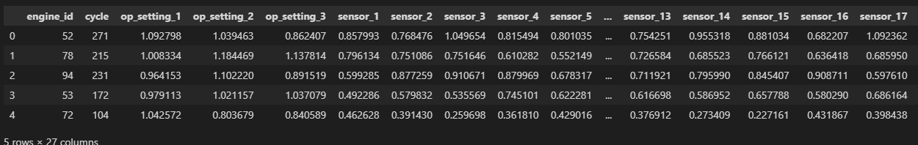
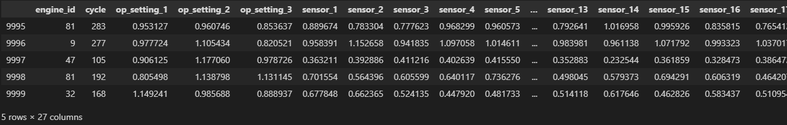
Exploratory Data Analysis
This the top 5 rows of the dataset here we see the how was the dataset values.
This the Bottom 5 rows of the dataset here we see the how was the dataset values.

Slide 42
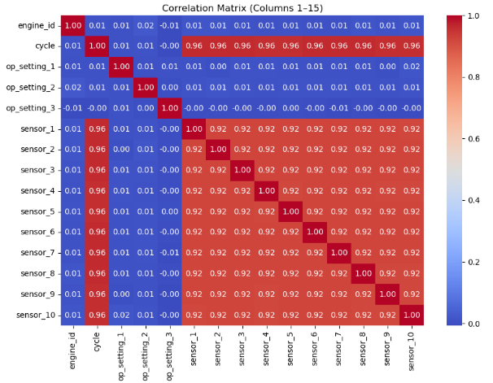
Exploratory Data Analysis

Slide 43
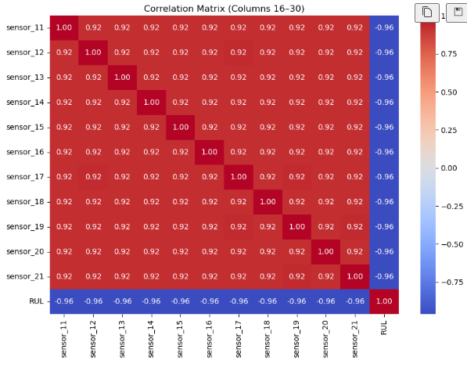
Exploratory Data Analysis

Slide 44
Exploratory Data Analysis
In the first heatmap (Columns 1–15), we see correlations among the engine operational settings, cycle count, and the first 10 sensors. The diagonal shows perfect correlation (1.0) since each variable correlates fully with itself. Most operational settings such as op_setting_1, op_setting_2, and op_setting_3 show very low correlation with other variables, indicating limited direct influence. On the other hand, the cycle variable is strongly correlated (0.96) with sensors 1–10, suggesting that as cycles progress, sensor readings change in a systematic way. Similarly, sensors 1–10 are highly correlated with each other (0.92), which implies redundancy in their measurements and possible multicollinearity issues. This indicates that not all sensors may contribute independently to predictive modeling, and dimensionality reduction techniques such as PCA or feature selection could be beneficial.

Slide 45
Exploratory Data Analysis
In the second heatmap (Columns 16–30), sensors 11–21 are analyzed along with RUL. Here, we again notice that sensors 11–21 are highly correlated with each other (0.92 across the board). Interestingly, all these sensors show a strong negative correlation with RUL (around –0.96). This means as the sensor values increase with engine degradation, the RUL consistently decreases, which is expected in predictive maintenance. The uniformity of correlation values indicates that these sensors capture similar degradation trends, making them reliable predictors of RUL.
Overall, the correlation analysis highlights two key insights: (1) strong interdependencies among sensors, which may require feature reduction to avoid redundancy, and (2) a strong negative correlation of multiple sensors with RUL, confirming their effectiveness in predicting equipment failure. These findings provide a solid foundation for selecting key features to build robust prognostic models.

Slide 46
Pre-processing steps
1.1 Data Upload and Acquisition Module
Accessible via the /upload route, this module allows users to upload CSV datasets containing aeroengine sensor and operational data. Key features include cycle numbers, temperature, pressure, vibration, and rotational speed readings. The uploaded data is parsed using Pandas, and the first 500 rows are displayed in a structured preview. This enables engineers or researchers to verify the dataset format before proceeding with model evaluation or prediction. Real-time manual data entry is also supported via the /prediction route for instant RUL prediction.
1.2 Data Validation and Preprocessing Module
All inputs, whether uploaded or manually entered, are validated for correct data type (float), non-null values, and operationally safe ranges (e.g., temperature, RPM). This ensures robust parsing and prevents inference errors. Feedback is provided through alerts in the front-end if invalid data is detected, maintaining prediction accuracy and reliability.

Slide 47
Pre-processing steps
1.3 Model Selection and Evaluation Module
The /model route enables users to select from multiple pre-trained machine learning models: Random Forest, Extra Trees Regressor, Gradient Boosting, XGBoost, KNN, FNN, and MLP. Each model’s performance metrics (MSE and R² Score) are displayed dynamically to help users select the most suitable model for RUL prediction. Extra Trees Regressor and MLP are highlighted for their superior predictive performance.
1.4 Prediction and Inference Module
At the /prediction route, user inputs across multiple telemetry parameters are processed by the selected serialized model (loaded using Joblib). The model outputs a numerical RUL prediction, which is then mapped to health categories: NORMAL, WARNING, and CRITICAL. The prediction, along with its health interpretation and maintenance suggestion, is displayed on prediction.html.

Slide 48
Pre-processing steps
1.5 Rule-Based Classification and Maintenance Recommendations
To support decision-making, RUL predictions are categorized as follows:
NORMAL: Engine is healthy and continues operation.
WARNING: Schedule maintenance soon; increase monitoring.
CRITICAL: Immediate inspection and maintenance required.
These categories allow operators to quickly interpret predictions and take actionable steps.
1.6 Security and Session Management
Secure login and registration are implemented via /login and /register. Features include:
CSRF protection using Flask-WTF
Session handling for sensitive routes (/upload, /model, /prediction)
Flash-based feedback for invalid login attempts or duplicate registrations
Future plans: password hashing with bcrypt and token-based verification

Slide 49
Pre-processing steps
2. User Management and Access Control
The User Management and Access Control module ensures secure, role-based, and seamless interaction with the RUL prediction system. It manages user registration, authentication, session handling, and access to private features, while maintaining data integrity and privacy.
2.1 Registration
The /register route allows new users to create an account by providing their name, email, and password. The system performs email uniqueness checks (case-insensitive) to prevent duplicate accounts and validates that the password and confirm password fields match. Once validated, the user’s credentials are stored in the MySQL users table. Future enhancements may include email verification, password hashing with bcrypt, and optional role-based access (e.g., admin, engineer) to control feature permissions.

Slide 50
Pre-processing steps
2.2 Login and Session Handling
Through the /login route, registered users can authenticate using their credentials. Successful login initiates a secure session, allowing access to restricted routes such as /upload, /model, and /prediction. Sessions expire upon logout or after a defined period of inactivity, preventing unauthorized access. Flash messages notify users of failed login attempts, incorrect passwords, or unregistered email IDs, ensuring user-friendly feedback.
2.3 Dataset Upload and Manual Input
Authorized users can upload CSV datasets through the /upload interface or manually enter sensor readings at /prediction. Uploaded datasets are parsed, validated, and previewed to ensure correct formatting. Real-time manual input enables immediate RUL prediction for individual engines, supporting urgent maintenance decisions.

Slide 51
Pre-processing steps
2.4 Model Evaluation Interface
The /model route presents all available machine learning models, including Random Forest, Extra Trees Regressor, Gradient Boosting, XGBoost, KNN, FNN, and MLP. Users can view dynamically updated performance metrics (MSE and R²) for each model. This interface allows comparison across models and selection of the most suitable algorithm based on predictive accuracy and reliability.
2.5 Prediction Output Visualization
Predicted RUL values are displayed alongside engine health classification—NORMAL, WARNING, CRITICAL—and actionable maintenance recommendations on prediction.html. The system provides intuitive color-coded indicators and textual guidance to help users quickly interpret the results and make informed operational decisions.

Slide 52
Pre-processing steps
2.6 Logout and Session Termination
Secure logout functionality ensures that all session data is cleared, preventing unauthorized reuse of sensitive session credentials. This maintains user privacy and system security. Future upgrades may include multi-factor authentication and audit logging of login activities for enhanced security.

Slide 53
Random Forest
The Random Forest Regressor is an ensemble learning algorithm that combines the predictions of multiple decision trees to improve accuracy and control overfitting. It works by constructing numerous decision trees during training time and averaging their outputs for regression tasks. Each tree is trained on a different bootstrap sample (randomly drawn subset) of the data, and only a random subset of features is considered when splitting nodes. This introduces randomness and diversity among the trees, making the ensemble more robust. Random Forest handles non-linear relationships well and is resistant to noise and outliers. It can estimate feature importance and works effectively without much hyperparameter tuning. One of its key strengths is its ability to generalize well on unseen data, especially when compared to individual decision trees which often overfit. However, it may become computationally expensive with a large number of trees or features. Overall, Random Forest is a powerful and widely-used regressor for a broad range of structured data problems.

Slide 54
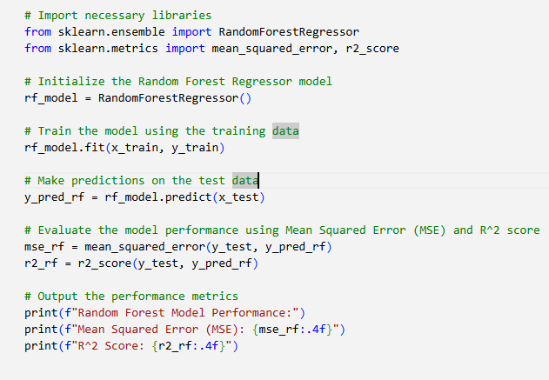

Results
PERFORMANCE Report
CODE

Slide 55
Results
Random Forest Regressor
Random Forest is a powerful ensemble technique that builds multiple decision trees and averages their outputs for regression tasks. It is well-suited for predicting aeroengine Remaining Useful Life (RUL), as it handles high-dimensional and non-linear sensor data like temperature, pressure, and vibration. Each tree is trained on bootstrapped samples, and splits use random subsets of features, improving diversity, reducing overfitting, and enhancing robustness against noisy readings. In this project, Random Forest achieved an MSE of 11.1807 and an R² of 0.9985, showing excellent accuracy. A key advantage is feature importance, which highlights the most critical sensors influencing predictions. The model was deployed with joblib and Flask, providing fast, interpretable real-time predictions. Its balance of accuracy, speed, and interpretability makes it ideal for aviation predictive maintenance.

Slide 56
Decision Tree :
The Decision Tree Regressor is a non-parametric supervised learning model used for predicting continuous target values. It works by recursively splitting the dataset into subsets based on the feature that results in the least prediction error, commonly measured using mean squared error (MSE). At each node, the algorithm finds the optimal threshold to split the data such that the target values within each child node are as homogeneous as possible. This process continues until a stopping criterion is met (e.g., max depth, min samples per leaf). Decision Trees are easy to interpret and visualize, making them useful for understanding relationships in data. However, they are prone to overfitting, especially when deep trees are grown without pruning. While efficient on small datasets, their performance may degrade with noisy data or irrelevant features. Despite this, Decision Tree Regressors are foundational models in machine learning and are often used as base learners in ensemble methods like Random Forest and Gradient Boosting.

Slide 57
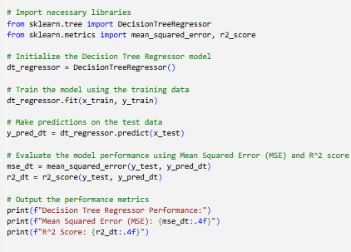

Results
PERFORMANCE Report
CODE

Slide 58
Results
🔸 Decision Tree Regressor:
Decision Tree Regressor is a supervised learning algorithm that partitions data into subsets based on feature thresholds, creating a tree-like structure of decisions. It is well-suited for predicting Remaining Useful Life (RUL) of aeroengines because it can model non-linear relationships in sensor data, including temperature, pressure, and vibration readings, without requiring feature scaling. Each leaf node represents a predicted RUL value based on training samples that satisfy the splits. In this project, the Decision Tree model achieved an MSE of 21.2120 and an R² of 0.9971, indicating reliable performance despite being less robust to noise than ensemble methods. Its main advantage is interpretability, as the tree structure allows engineers to trace how specific sensor readings influence predictions. Deployed via Flask, it provides real-time, actionable insights for proactive maintenance planning.

Slide 59
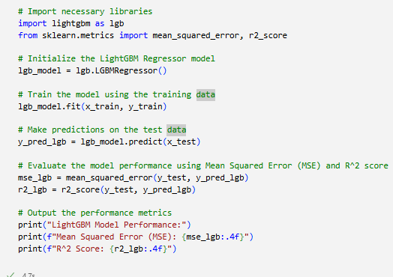
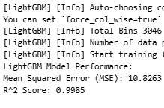
Results
PERFORMANCE REPORT
CODE

Slide 60
Results
Decision Tree Regressor is a supervised learning algorithm that partitions data into subsets based on feature thresholds, creating a tree-like structure of decisions. It is well-suited for predicting Remaining Useful Life (RUL) of aeroengines because it can model non-linear relationships in sensor data, including temperature, pressure, and vibration readings, without requiring feature scaling. Each leaf node represents a predicted RUL value based on training samples that satisfy the splits. In this project, the Decision Tree model achieved an MSE of 21.2120 and an R² of 0.9971, indicating reliable performance despite being less robust to noise than ensemble methods. Its main advantage is interpretability, as the tree structure allows engineers to trace how specific sensor readings influence predictions. Deployed via Flask, it provides real-time, actionable insights for proactive maintenance planning.
60

Slide 61
KNN
The K-Nearest Neighbors (KNN) Regressor is a non-parametric, instance-based learning algorithm that makes predictions based on the values of the k closest training data points in the feature space. Unlike most other models, KNN does not learn an internal model during training; instead, it memorizes the training data and performs calculations during prediction. To predict the output for a new instance, the algorithm identifies the k nearest neighbors using a distance metric like Euclidean distance and computes the average (or weighted average) of their target values. KNN is simple, intuitive, and effective for small datasets with well-structured relationships. However, it is highly sensitive to feature scaling, irrelevant features, and the choice of k. It also suffers from high computational costs during prediction, especially for large datasets, since it needs to search through all training data. Despite its limitations, KNN can perform well when the data has a clear local structure and low dimensionality.

Slide 62
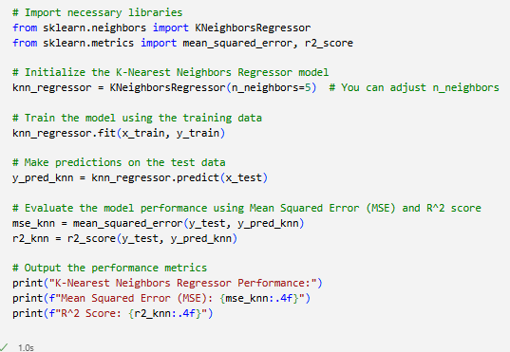

Results
PERFORMANCE REPORT
CODE

Slide 63
🔸 K-Nearest Neighbors (KNN) Regressor:
The K-Nearest Neighbors (KNN) Regressor model shows relatively weaker performance compared to other models in the project. It recorded a high Mean Squared Error (MSE) of 1261.2236 and a lower R² score of 0.9878. Although the R² is still strong, the high MSE indicates a greater deviation between predicted and actual values. This performance suggests that KNN may not generalize well for this particular task involving temporal battery behavior prediction. Since KNN is a non-parametric, instance-based learning method, it relies heavily on the choice of ‘k’ value and distance metric. While it is simple and intuitive, KNN may struggle with high-dimensional data or datasets with noise, which could explain the large error. Therefore, although KNN can be used for regression, it is not ideal for complex predictive maintenance systems where accuracy and robustness are critical. More advanced models like Random Forest or Gradient Boosting are preferred in such cases.
63

Slide 64
MLP
A Multi-Layer Perceptron (MLP) is a class of feedforward artificial neural networks that consists of an input layer, one or more hidden layers, and an output layer. Each layer is composed of neurons that are fully connected to the next, and each neuron applies an activation function to the weighted sum of its inputs. MLPs are capable of learning complex nonlinear mappings from input to output, making them ideal for both classification and regression problems. In regression tasks like Remaining Useful Life (RUL) prediction, MLPs are trained to minimize loss functions such as Mean Squared Error. Their strength lies in the ability to learn hidden representations of data, especially when relationships among variables are not strictly linear. MLPs require careful tuning of hyperparameters like learning rate, number of hidden layers, and activation functions. Despite their simplicity compared to deeper architectures, MLPs are widely used in practical machine learning applications for their balance of accuracy and efficiency.

Slide 65
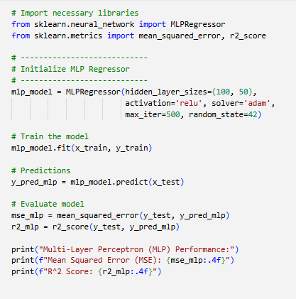

Results
PERFORMANCE REPORT
CODE

Slide 66
Results
🔸 MLP:
Multi-Layer Perceptrons (MLPs) extend feedforward networks by adding multiple hidden layers, allowing deeper representation of complex feature interactions. Each layer transforms sensor inputs through weighted connections and non-linear activations, progressively extracting higher-level features. For aeroengine RUL prediction, MLPs capture subtle dependencies among vibration, temperature, and pressure readings. In this project, MLP achieved an MSE of 12.0854 and an R² of 0.9984, reflecting strong predictive accuracy. Training used dropout and early stopping to mitigate overfitting, improving generalization to unseen cycles. Integrated into the Flask web app, MLP delivers real-time RUL predictions critical for proactive maintenance planning. Its deep architecture provides greater flexibility than simpler models, and when combined with ensemble regressors, it can further improve system robustness, offering a powerful solution for predictive aviation systems.
66

Slide 67
FNN
A Feedforward Neural Network (FNN) is one of the simplest and most widely used types of artificial neural networks. It consists of an input layer, one or more hidden layers, and an output layer, where information flows in only one direction—from input to output—without any feedback loops or cycles. Each neuron in a layer is connected to every neuron in the next layer, and the connections are assigned weights that are adjusted during training. FNNs use activation functions such as ReLU or sigmoid to introduce non-linearity, enabling them to model complex patterns. In regression tasks, such as predicting Remaining Useful Life (RUL) or energy consumption, FNNs are effective because they can approximate a wide range of continuous functions. Their simplicity makes them easy to implement and interpret, while still providing high accuracy when appropriately configured. FNNs are foundational models that serve as a baseline for many advanced neural network architectures in both research and real-world applications.

Slide 68
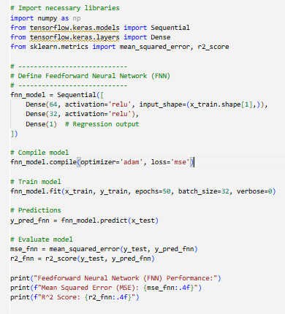

Results
PERFORMANCE REPORT
CODE

Slide 69
🔸 FNN Result:
Feedforward Neural Networks (FNNs) are basic neural networks where data flows in one direction—from inputs, through hidden layers, to outputs. In aeroengine RUL prediction, FNNs capture non-linear relationships in multivariate sensor data such as pressure, temperature, and vibration. Each neuron processes inputs via weighted connections and activation functions like ReLU, enabling complex pattern learning. In this project, the FNN achieved an MSE of 17.8211 and an R² of 0.9976, showing strong performance despite slightly lower accuracy than ensemble models. Training used backpropagation with gradient descent, along with regularization to reduce overfitting. Integrated into Flask, FNN provides real-time predictions, enhancing usability in maintenance systems. Though simpler than deep recurrent models, FNNs remain flexible, interpretable, and effective, making them valuable standalone predictors or components of hybrid ensemble frameworks.
69

Slide 70
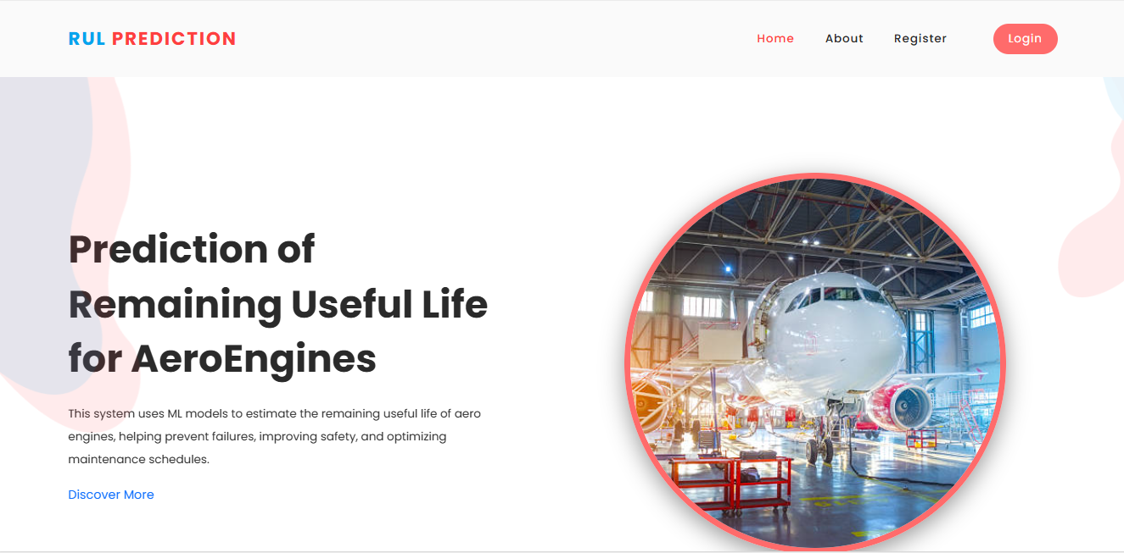
OUTPUT SCREEN SHOTS WITH DESCRIPTION.
Home Page:The HomePage serves as the landing page of your application. It provides an overview of the project's features, objectives, and benefits. Users can navigate to other sections of the application from this page.

Slide 71
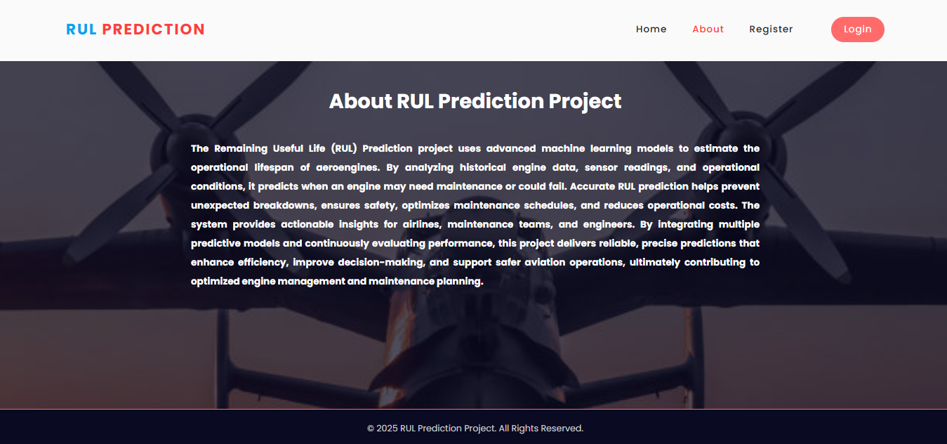
AboutPage: The AboutPage offers detailed information about the project, including its purpose, goals, and the technology used. It provides background information on the problem being addressed and the methods employed.

Slide 72
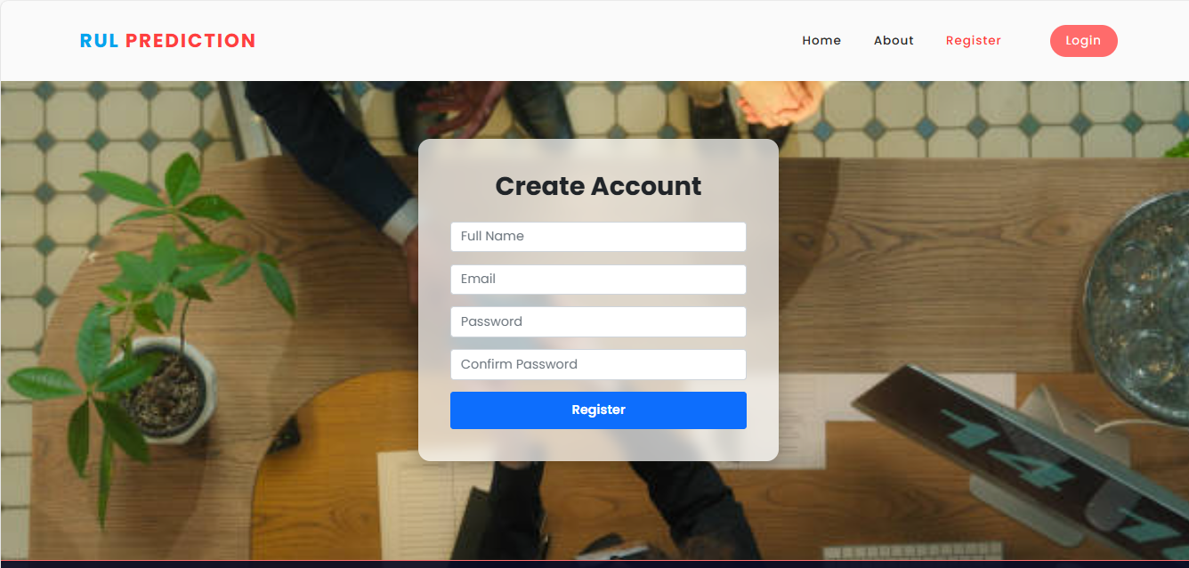
Registration Page: The Registration Page allows new users to create an account with the application. It typically includes fields for entering personal information such as name, email, password, and possibly other details like phone number or address. Users need to fill out this form to gain access to the application's features.

Slide 73
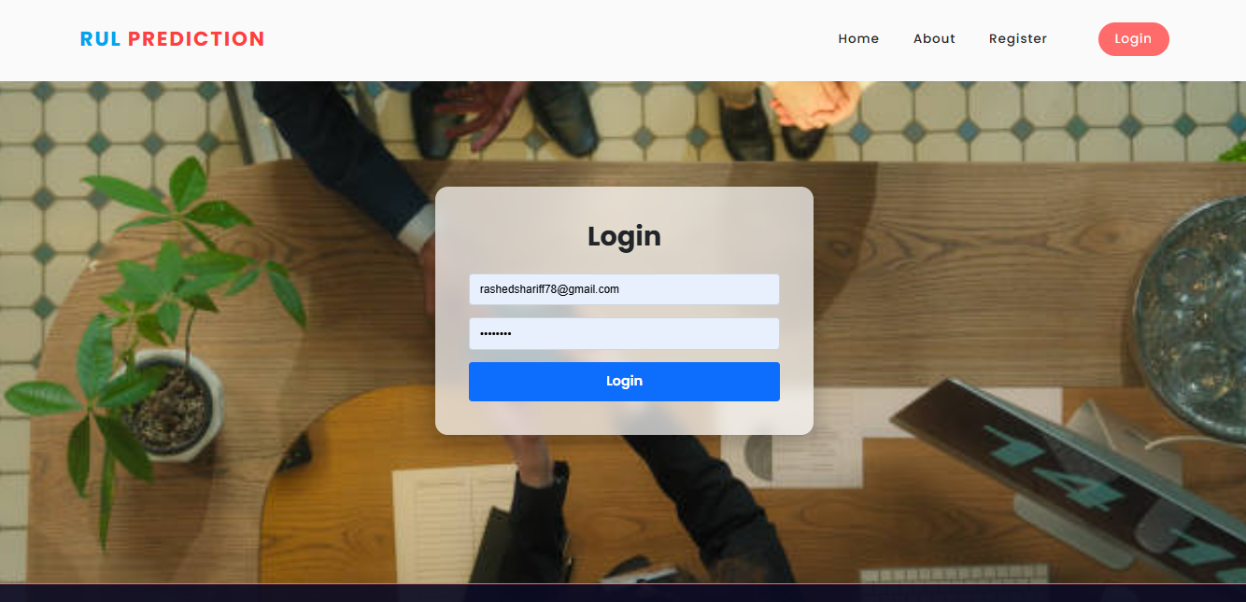
Login: The login page allows registered users to securely access the application. User have to provide register email and password.

Slide 74
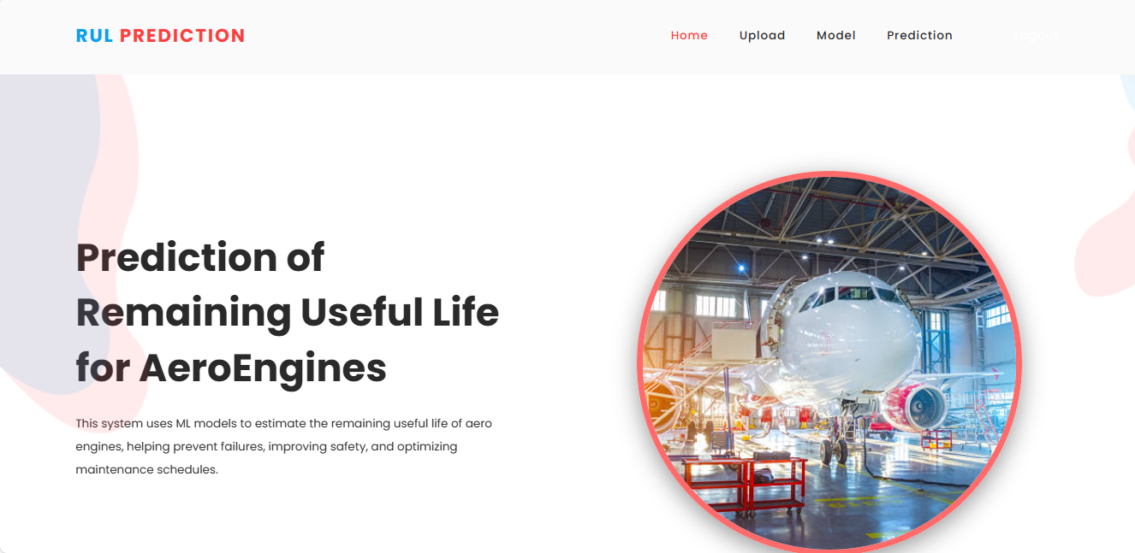
Home Page:The HomePage serves as the landing page of your application.

Slide 75
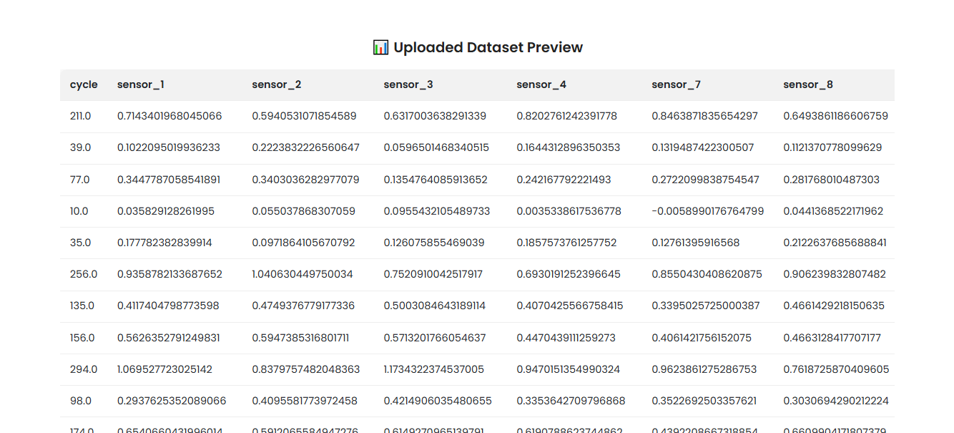
UPLOAD PAGE: Here you can upload the dataset and view the dataset

Slide 76
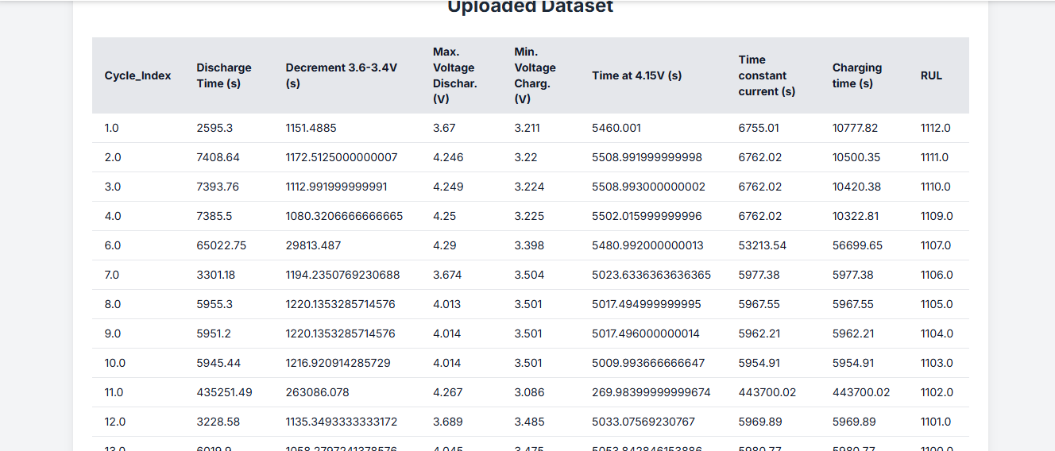
UPLOAD PAGE: Here you can upload the dataset and view the dataset

Slide 77
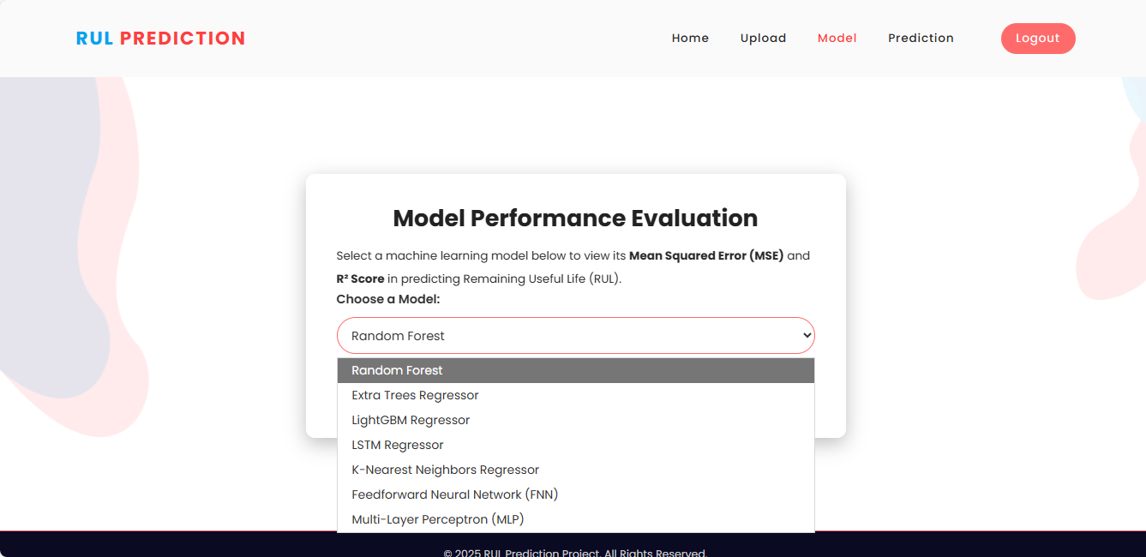
Model Selection: Here user have to select the model and and view the accuracy so that we know which algorithm is giving the highest accuracy.

Slide 78
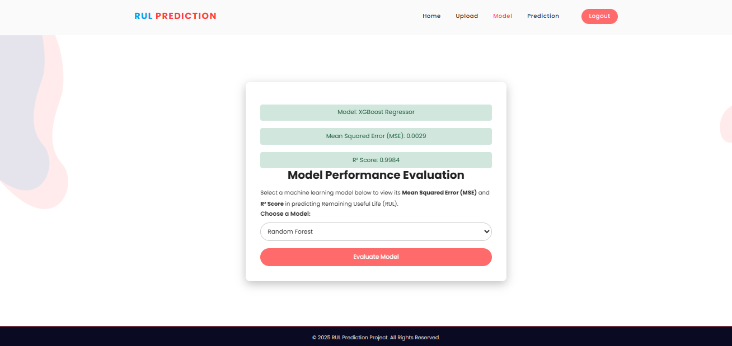
Model Selection: Here user have to select the model and and view the accuracy so that we know which algorithm is giving the highest accuracy.

Slide 79
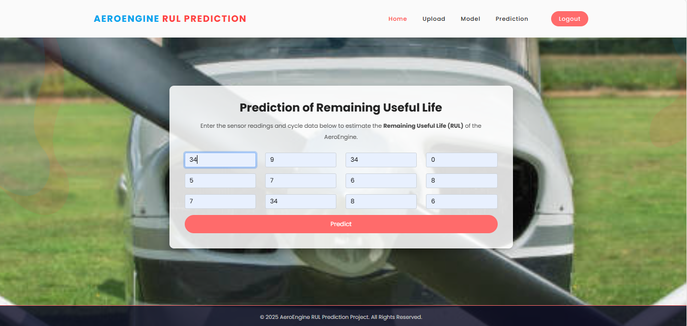
Prediction: This is the prediction page here user have to provide values of a 20 features and our model is predict the final output.

Slide 80
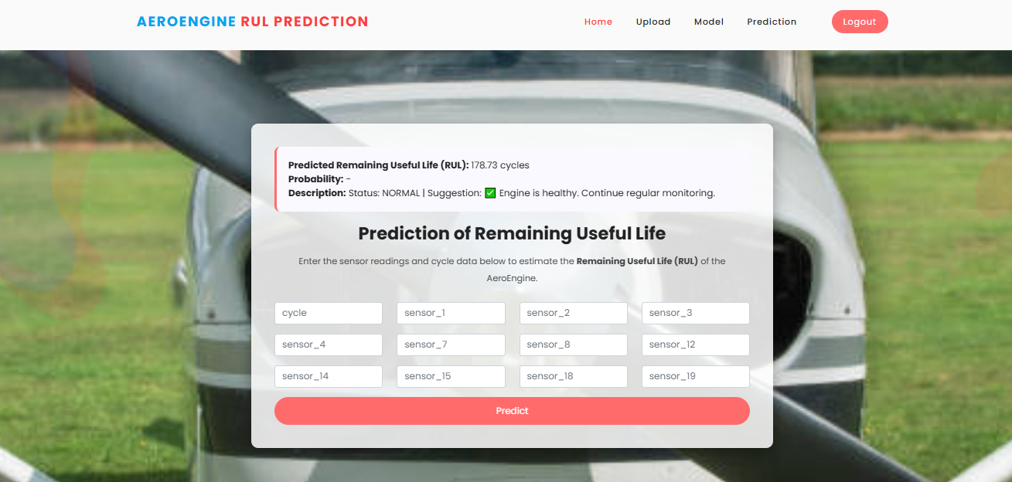
Prediction: This is the prediction page here user have to provide values of a 20 features and our model is predict the final output.

Slide 81
Future Scope
The prediction of aeroengine Remaining Useful Life (RUL) has significant potential for further enhancement and application. Future work can incorporate real-time streaming data from IoT-enabled sensors onboard aircraft to continuously update RUL predictions, improving proactive maintenance scheduling. Integration of hybrid models, combining ensemble tree-based approaches with deep learning architectures, may further enhance prediction accuracy for complex operational conditions. The system can also be extended to include multi-engine fleet analysis, enabling optimized maintenance across multiple aircraft. Additionally, advanced Explainable AI (XAI) techniques beyond SHAP, such as LIME or counterfactual analysis, could provide deeper insights into engine behavior and maintenance decision-making. Incorporating cloud-based deployment, automated notifications, and predictive dashboards would make the solution scalable and operationally robust for the aviation industry.

Slide 82
Conclusion
This project successfully demonstrates the feasibility and effectiveness of using advanced machine learning models for predicting the Remaining Useful Life of aeroengines. By evaluating multiple algorithms—including Random Forest, Extra Trees Regressor, Gradient Boosting, XGBoost, KNN, FNN, and MLP—it was determined that Extra Trees Regressor and MLP offer the most reliable and accurate predictions. The integration of SHAP-based Explainable AI provides transparency in feature contributions, fostering trust in model decisions. The deployment of the system as a Flask-based web application enables real-time data input, model comparison, and actionable maintenance recommendations. Overall, this research contributes to enhanced aviation safety, reduced operational costs, and improved reliability, offering a scalable framework for predictive maintenance in the aerospace sector.

Slide 83
REFERENCES
[1] Elsherif, S. M., et al. (2025). "A deep learning-based prognostic approach for predicting the remaining useful life of aero-engines." Scientific Reports. Available: https://www.nature.com/articles/s41598-025-09155-z
[2] Zha, W. (2024). "An aero-engine remaining useful life prediction model based on feature extraction and improved temporal convolution network." ScienceDirect. Available: https://www.sciencedirect.com/science/article/pii/S2773186324000148
[3] Zhou, Z. (2024). "An aircraft engine remaining useful life prediction method based on prediction vector angle minimization and feature fusion gate improved transformer." ScienceDirect. Available: https://www.sciencedirect.com/science/article/abs/pii/S0278612524001870
[4] Alomari, Y., et al. (2023). "Advancing aircraft engine RUL predictions: An interpretable integrated approach of feature engineering and aggregated feature importance." Scientific Reports. Available: https://www.nature.com/articles/s41598-023-40315-1

Slide 84
REFERENCES
[5] Deng, S., et al. (2024). "Prediction of remaining useful life of aero-engines based on CNN-LSTM-attention." International Journal of Computational Intelligence Systems. Available: https://link.springer.com/article/10.1007/s44196-024-00639-w
[6] Chen, J., et al. (2023). "Aero-engine remaining useful life prediction method with multimodal data fusion and ensemble transfer learning." ScienceDirect. Available: https://www.sciencedirect.com/science/article/abs/pii/S0951832023000662
[7] Liu, Q., et al. (2024). "Enhancing aircraft engine remaining useful life prediction via transfer learning." Oxford Academic Journal of Computational Design and Engineering. Available: https://academic.oup.com/jcde/article/11/1/343/7610897
[8] Shi, J., et al. (2023). "Adaptively lightweight spatiotemporal information extraction for aero-engine RUL prediction using Involution GRU." PMC. Available: https://pmc.ncbi.nlm.nih.gov/articles/PMC10346437/

Slide 85
REFERENCES
[9] Wang, H., et al. (2024). "Aeroengine remaining life prediction using feature aggregation and evaluation metrics." Wiley Online Library. Available: https://onlinelibrary.wiley.com/doi/10.1155/2024/6465566
[10] Wu, F., et al. (2024). "Remaining useful life prediction based on deep learning: A survey." PMC. Available: https://pmc.ncbi.nlm.nih.gov/articles/PMC11174398/
[11] Biggio, L., et al. (2021). "Uncertainty-aware remaining useful life predictor." arXiv. Available: https://arxiv.org/abs/2104.03613
[12] Khan, T., et al. (2022). "An explainable regression framework for predicting remaining useful life of machines." arXiv. Available: https://arxiv.org/abs/2204.13574

Slide 86
THANK YOU

